Slide 1

Distributed Anomaly Detection in Wireless Sensor Networks
Ammara Razzaq
U00045665

Slide 2
Outline
Introduction
Problem Statement
Anomaly Detection
Evaluation
Conclusion

Slide 3
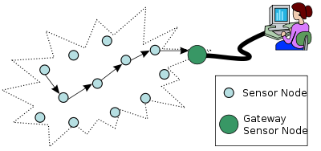
Introduction
Wireless Sensor Network

Slide 4
Introduction
Wireless sensor networks
  Limited power, bandwidth, memory.
  More vulnerable to faults and malicious attacks.
  Anomalies in sensor data.

Slide 5
Problem Statement
Identify anomalies in the data gathered by sensor nodes in WSN.
An outlier or anomaly in a set of data is defined as an observation that appears to be inconsistent with the remainder of that data set.

Slide 6
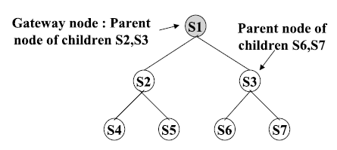
Problem Statement
Hierarchical topology.

Slide 7
Anomaly Detection
Data Conditioning
Clustering
Anomaly Detection Algorithm
Merging of clusters

Slide 8
Anomaly Detection
Centralized Approach
Distributed Approach
VS

Slide 9
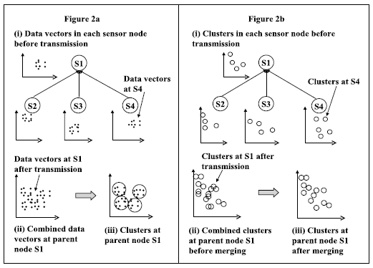
Anomaly Detection

Slide 10
Anomaly Detection
Centralized Approach
Distributed Approach
Active mode for communication for longer time duration reduces the life time of the network.
Greater communication load for large volumes of raw data.
Complete data information at gateway node leads to better accuracy.
Better load balancing by distributing the clustering process between all the nodes.
Reduced communication overhead by only sending the merged clusters.
Only merged cluster information at gateway node leads to slightly reduced accuracy.

Slide 11
Anomaly Detection
Each sensor node performs the clustering operation on its local data.
Each sensor node sends the sufficient statistics of its clusters to its immediate parent.
The parent node combines its clusters with the clusters from its immediate children.

Slide 12
Anomaly Detection
The parent node merges the combined cluster set to produce a merged cluster set.
Then the parent node sends the sufficient statistics of the merged clusters to its immediate parent.
The process continuous recursively up to the gateway node where anomaly detection algorithm is applied.

Slide 13
Anomaly Detection
Anomaly detection is a four step process.
  Data Conditioning
  Clustering Algorithm
  Merging of Clusters
  Anomaly Detection Algorithm

Slide 14
Data Conditioning
Data conditioning transforms the data vectors from sensor measurements to a suitable form for use in distance based clustering.
Each data vector is transformed via their respective mean and variance.
The resulting transformed feature will have zero mean and unit variance.

Slide 15
Data Conditioning
Each sensor node computes the following information on its local data.
Each node sends the above information to the gateway node.

Slide 16
Data Conditioning
3. Gateway node computes the global data conditioning parameters and sends to all children.
4. Each local node uses these parameters to condition its local data.

Slide 17
Clustering Algorithm
Fixed width clustering: creates sets of fixed width clusters.
w is specified by user.
Produces a set of disjoint, fixed width clusters in the feature space.
Only one pass is required through the data.

Slide 18
Clustering Algorithm
Step 1: a data vector is taken and used as centroid of the first cluster with radius w.
Step 2: for each subsequent data vector the Euclidean distance between the centroid of the current cluster and this data vector is computed.
  If (distance) < w ,then data vector is added to the cluster
  Else , a new cluster is created with data vector as centroid.

Slide 19
Clustering Algorithm
C2
C4
C3
C1

Slide 20
Merging of Clusters
Combine a pair of similar clusters into single cluster.
Similar clusters: if d(c1,c2) < w
A new cluster c3 is produced with:
  Centre = mean of centers of c1 and c2.
  n = n1 + n2

Slide 21
Anomaly Detection Algorithm
Identify clusters as either normal or anomalous.
Average inter-cluster distance of K nearest neighbor (KNN) clusters is used.

Slide 22
Anomaly Detection Algorithm
Step 1: For each cluster a set of inter cluster distances is computed.
For example for cluster c4
    d(c4,c2) = 10.9344
    d(c4,c3) = 8.560
    d(c4,c1) = 15.193

Slide 23
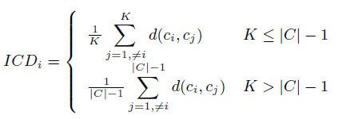
Anomaly Detection Algorithm
Step 2: Average inter-cluster distance for each cluster is computed by selecting K shortest distances.
For cluster c4, K=2
    d(c4,c2) = 10.9344
    d(c4,c3) = 8.560 ICDi = 9.7472

Slide 24
Anomaly Detection Algorithm
Step 3: A cluster is identified as anomalous if it satisfies the following equation.

Slide 25
Evaluation
Experiments are performed on 3 level hierarchy topology.
A uniformly distributed randomly generated set of anomalous data was introduced.
Experiments are performed for different cluster widths.
False positive and false negative rates are calculated.

Slide 26
Evaluation
False positive: a normal measurement is identified as anomalous.
False negative: an anomalous measurement is identified as normal.
FPR = false positives / actual normal measurements
FNR = false negatives / actual anomalous measurements

Slide 27
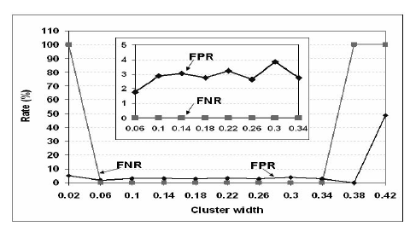
Evaluation
For centralized scheme

Slide 28
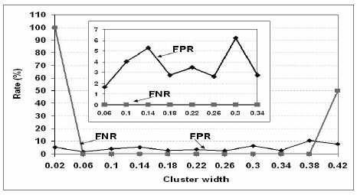
Evaluation
For distributed scheme

Slide 29
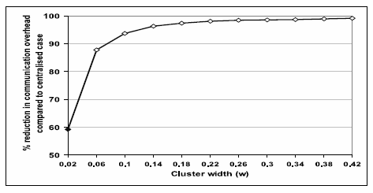
Evaluation
Reduction in communication overhead in the network vs. cluster width.

Slide 30
Related Work
Statistical based anomaly detection
Classification based anomaly detection
Nearest neighbor based anomaly detection.

Slide 31
Conclusion
A distributed anomaly detection algorithm based on data clustering to identify misbehaviors in a WSN.
Comparable performance with the centralized case.
Significant reduction in communication overhead.

